Slide 1



Slide 2

AN INTRODUCTION TO DECA’S COMPETITIVE EVENTS PROGRAM

Slide 3

INTENDED
OUTCOMES

Slide 4
COMPETITIVE EVENTS
CONNECTION
National Curriculum Standards
Career Clusters®
21st Century Skills

Slide 5
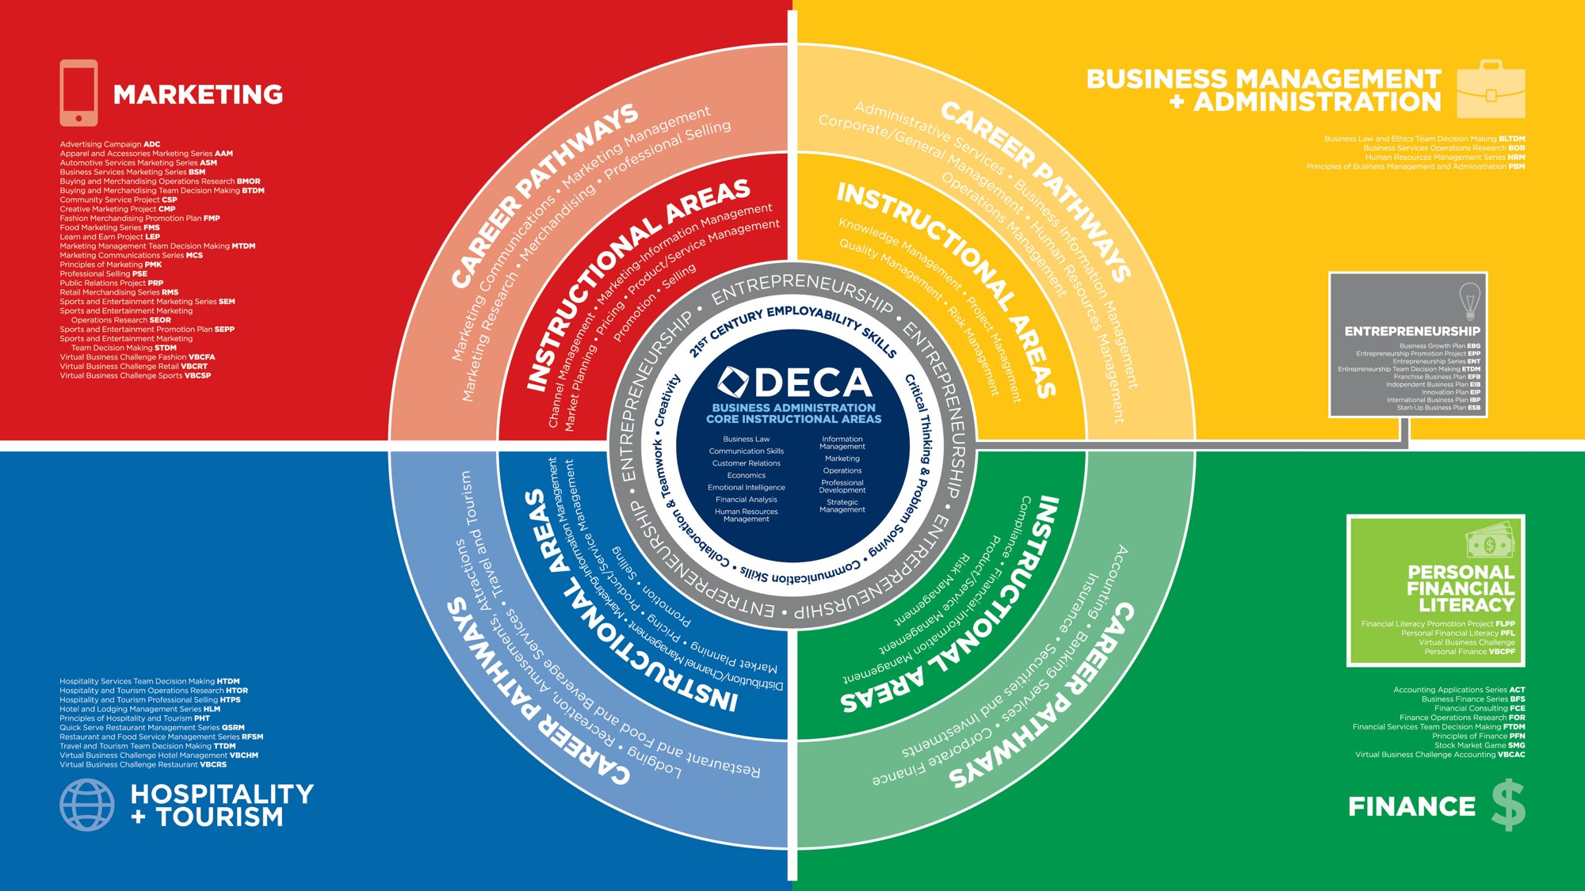

Slide 6
CATEGORIES OF COMPETITIVE EVENTS
ROLE-PLAY EVENTS
Principles of Business
Administration Events
Team Decision Making Events
Individual Series Events
Personal Financial Literacy
ONLINE EVENTS
Stock Market Game
Virtual Business Challenges
WRITTEN AND PREPARED EVENTS
Business Operations Research Events
Chapter Team Events
Entrepreneurship Events
Integrated Marketing Campaign Events
Professional Selling and Consulting Events

Slide 7

PRINCIPLES OF BUSINESS ADMINISTRATION EVENTS
Designed for first-year DECA members in an introductory business/marketing course.

Slide 8

TEAM DECISION MAKING EVENTS
Designed for teams to analyze a case study.

Slide 9

INDIVIDUAL SERIES EVENTS
Designed for members with substantial knowledge/experience in the career area.

Slide 10

PERSONAL FINANCIAL LITERACY EVENT
Designed to measure the personal finance knowledge and skills and measure the member’s ability to apply decision making to personal financial decisions.

Slide 11



BUSINESS OPERATIONS RESEARCH EVENTS
New topic is provided each year in DECA Guide.

Slide 12

CHAPTER TEAM EVENTS
Designed as opportunities to engage all chapter members in large events/projects.
Require members to plan, implement and evaluate a project in your school/community.

Slide 13


ENTREPRENEURSHIP EVENTS
Designed for members interested in owning/operating their own business.
Provides a continuum from innovation to start-up to growing an existing business.

Slide 14

INTEGRATED MARKETING CAMPAIGN EVENTS
Designed to allow members to develop an integrated marketing campaign of no more than 45 days in length for a real event, product or service and present the campaign in a role-play situation.

Slide 15

PROFESSIONAL SELLING AND CONSULTING EVENTS
Designed for members to demonstrate their selling or consulting abilities.
New products/services are provided each year in DECA Guide.

Slide 16


ONLINE EVENTS
Stock Market Game
Virtual Business Challenge

Slide 17
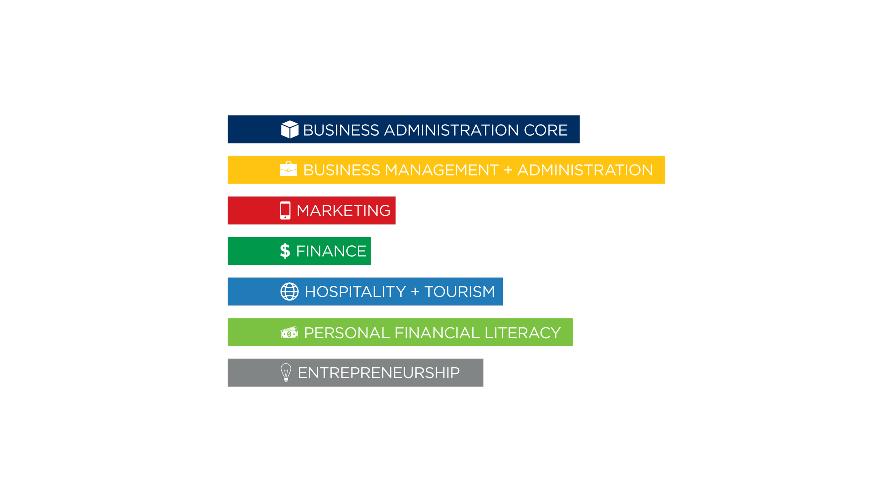

PERFORMANCE INDICATOR LISTS

Slide 18
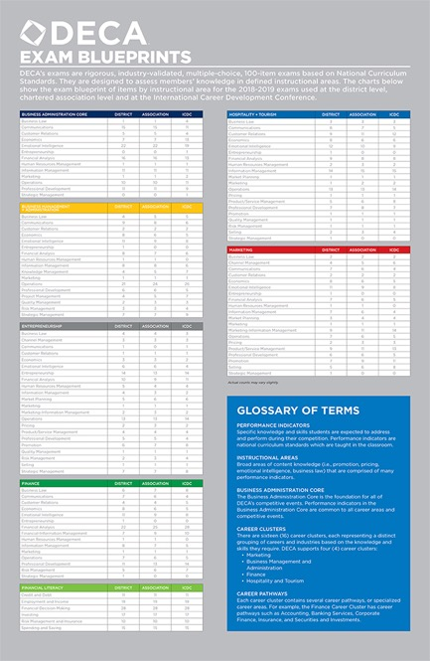
DECA EXAMS

Slide 19
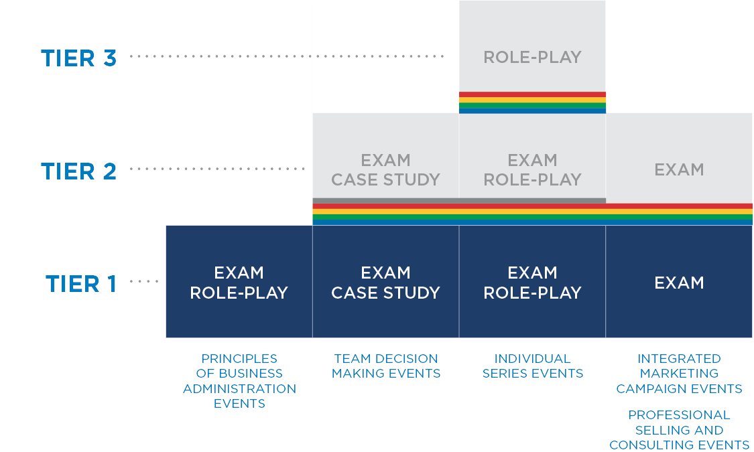
UNDERSTANDING TIERS

Slide 20
HOW DO YOU HELP MEMBERS SELECT THE RIGHT EVENT?
Career interests
Job experience
Match strengths to event format
  Are they strong test takers?
  Are they strong presenters?
  Do they prefer as much preparedness as possible?
  Do they work well with others?

Slide 21


Slide 22
FINAL
THOUGHTS

